Slide 1
Neural networks and CNN
Biplab Banerjee

Slide 2
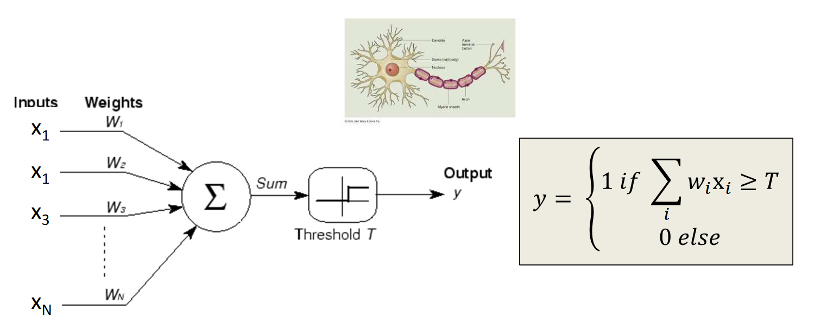
Perceptron Model
Frank Rosenblatt (1957) - Cornell University

Slide 3
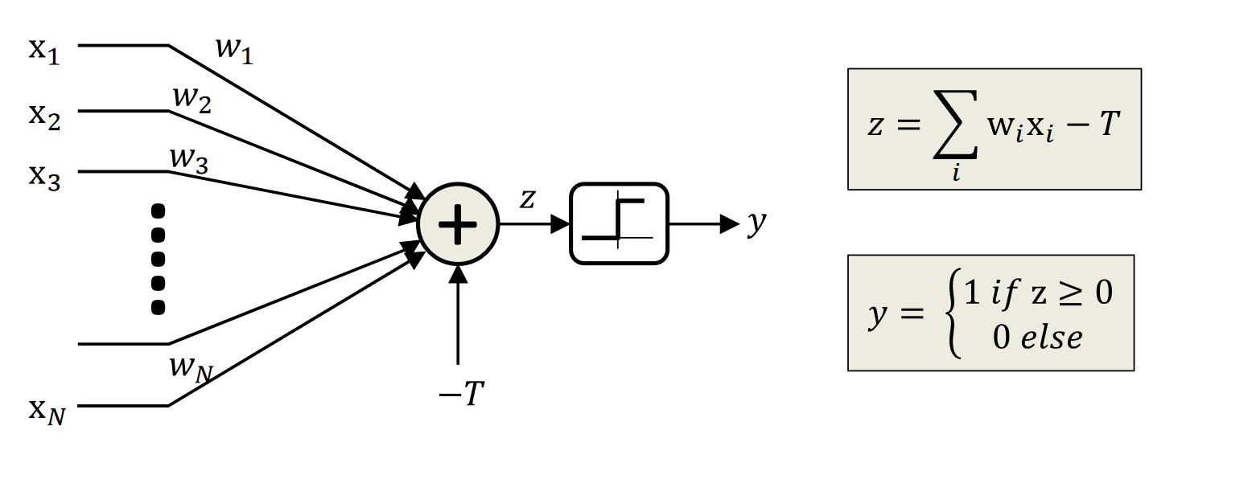

Slide 4
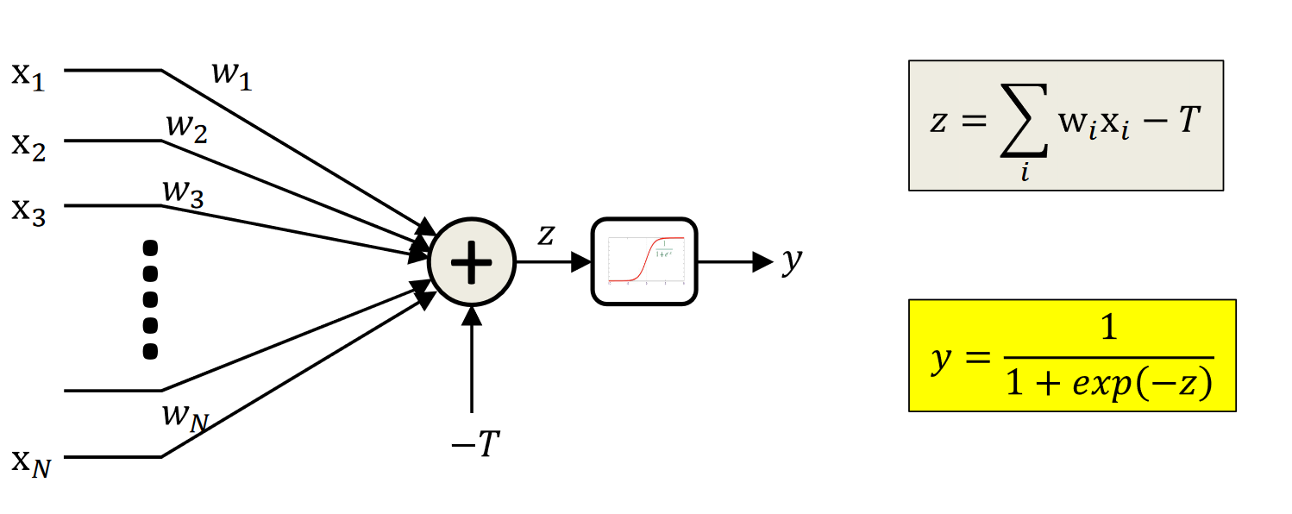

Slide 5
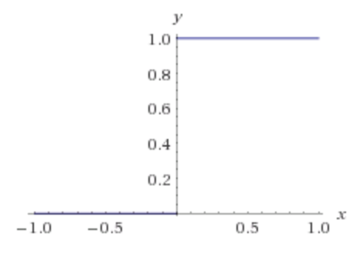
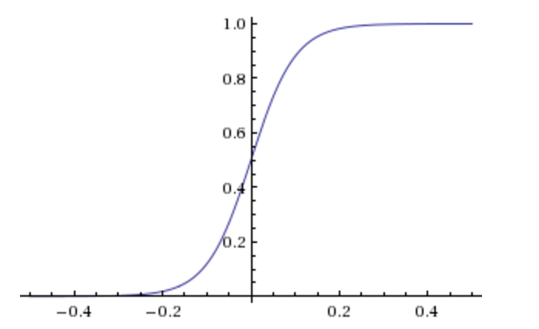
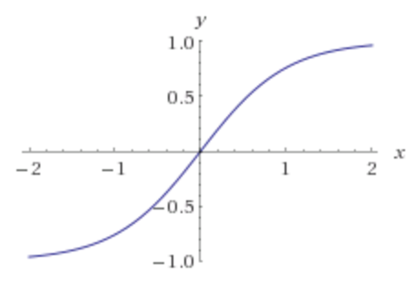
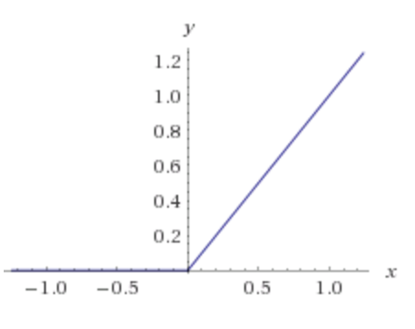
Activation Functions
Step(x)
Sigmoid(x)
Tanh(x)
ReLU(x) = max(0, x)

Slide 6
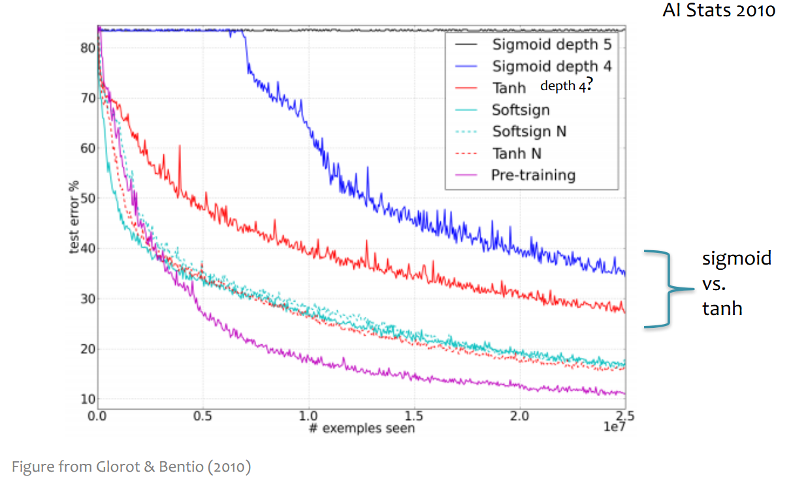

Slide 7
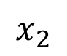
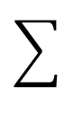
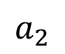
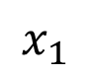
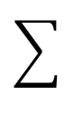
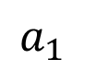
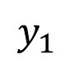
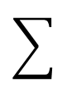
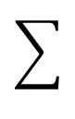
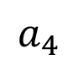
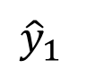
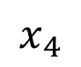
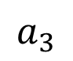
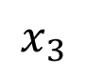
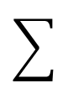
Two-layer Multi-layer Perceptron (MLP)
”hidden" layer
Loss / Criterion
$$x_{1}$$
$$a_{1}$$
$$x_{2}$$
$$a_{2}$$
$${\hat{y}}_{1}$$
$$y_{1}$$
$$x_{3}$$
$$a_{3}$$
$$x_{4}$$
$$a_{4}$$

Slide 8
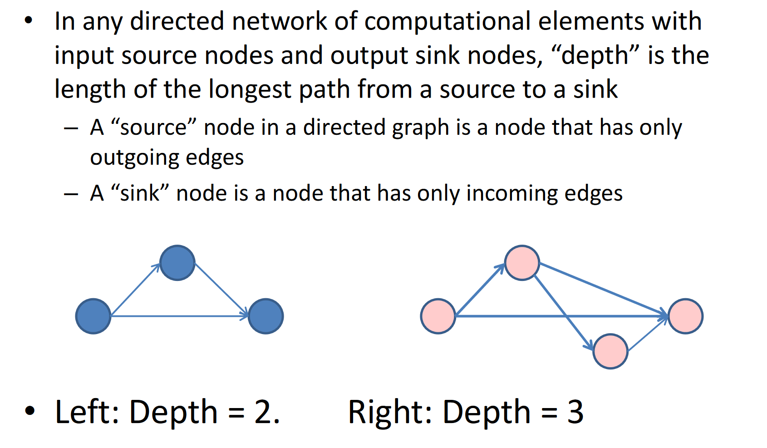

Slide 9
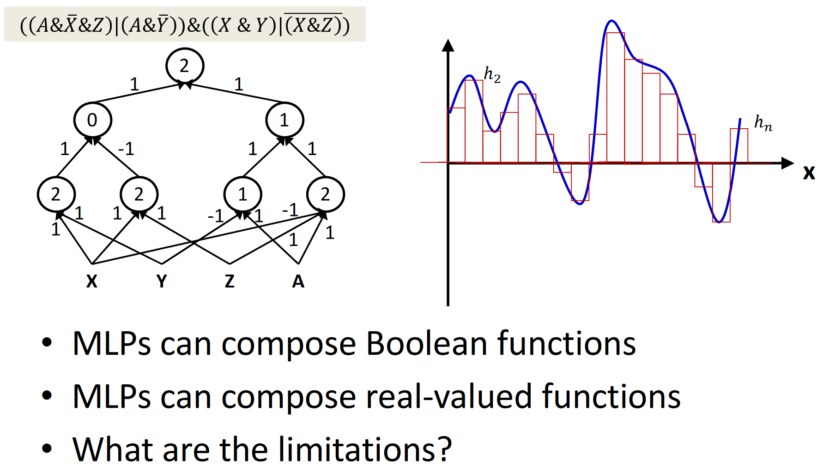

Slide 10
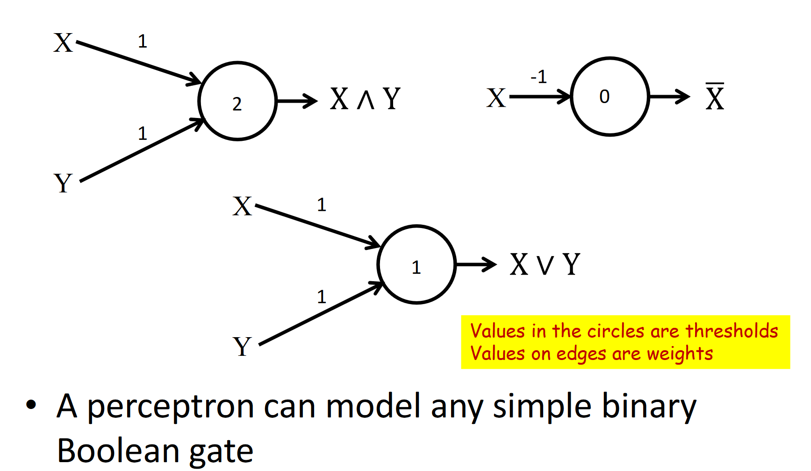

Slide 11
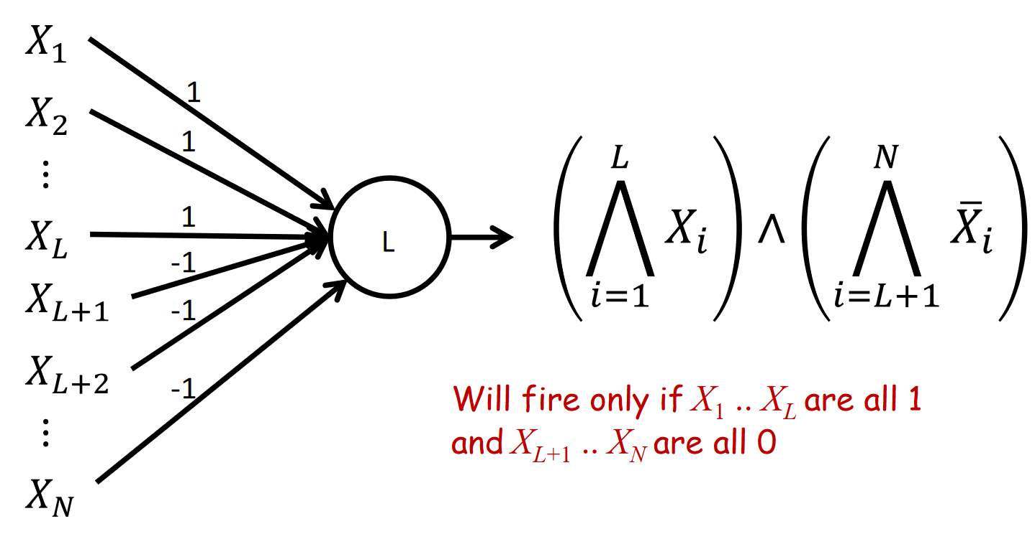
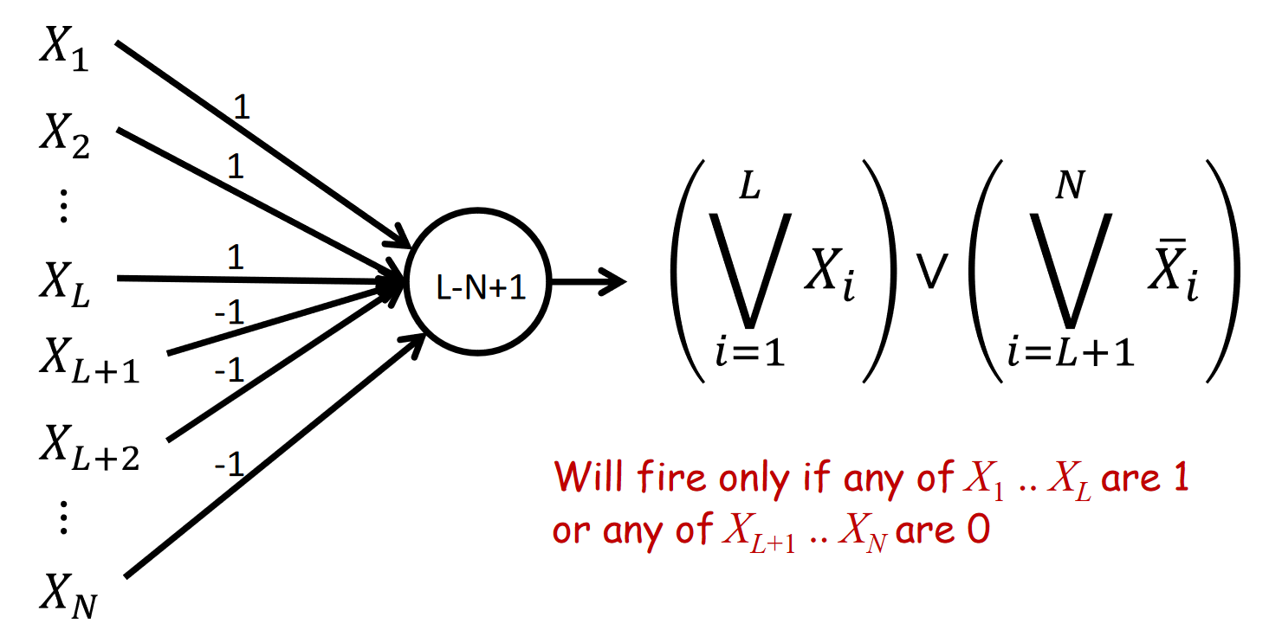

Slide 12
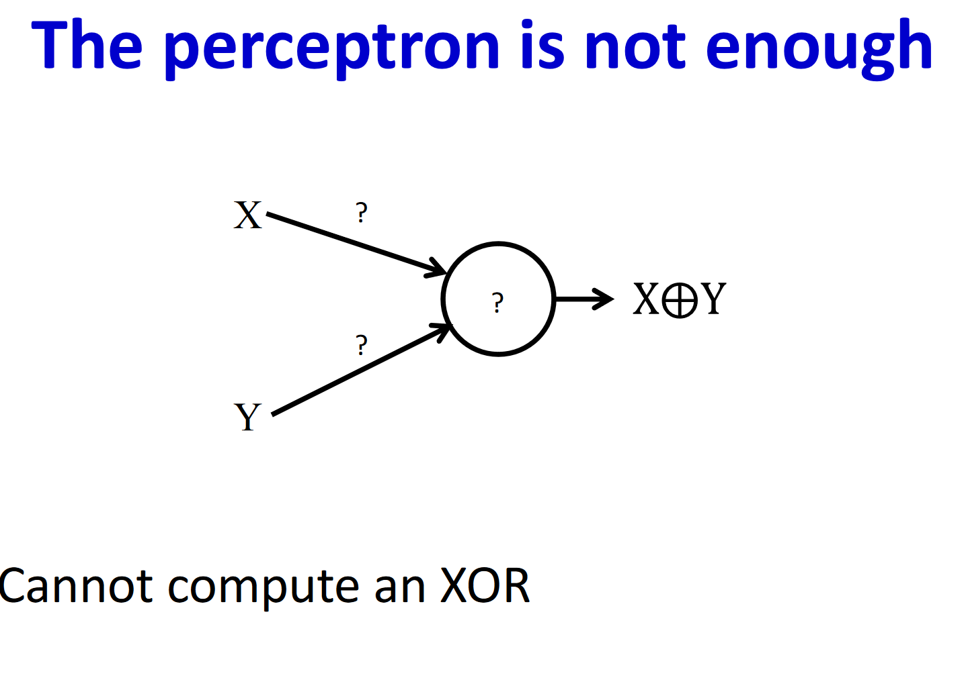

Slide 13
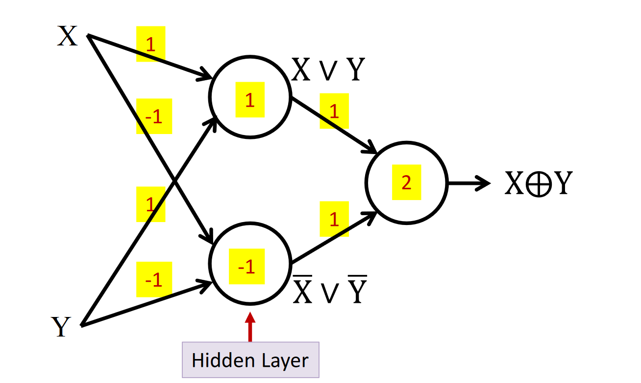

Slide 14
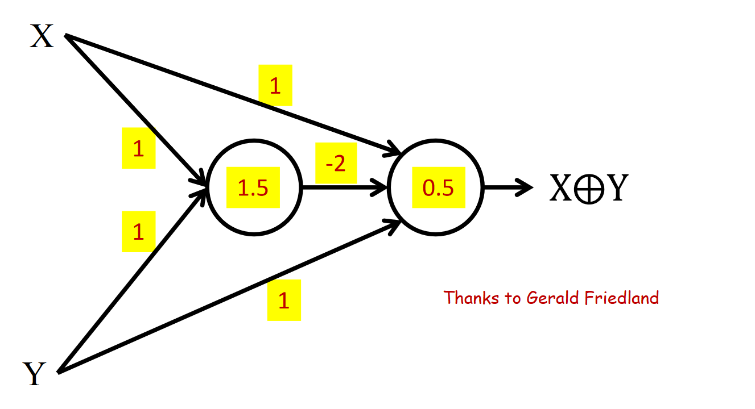

Slide 15
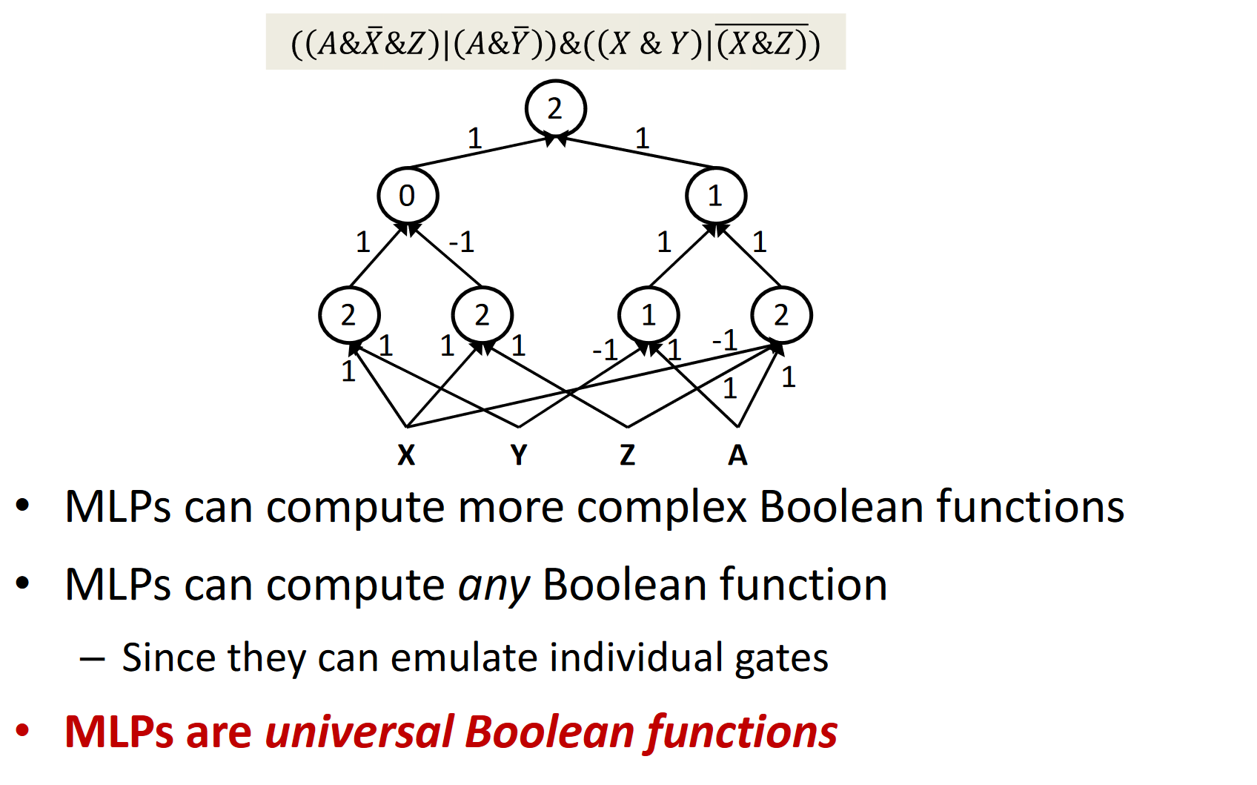

Slide 16
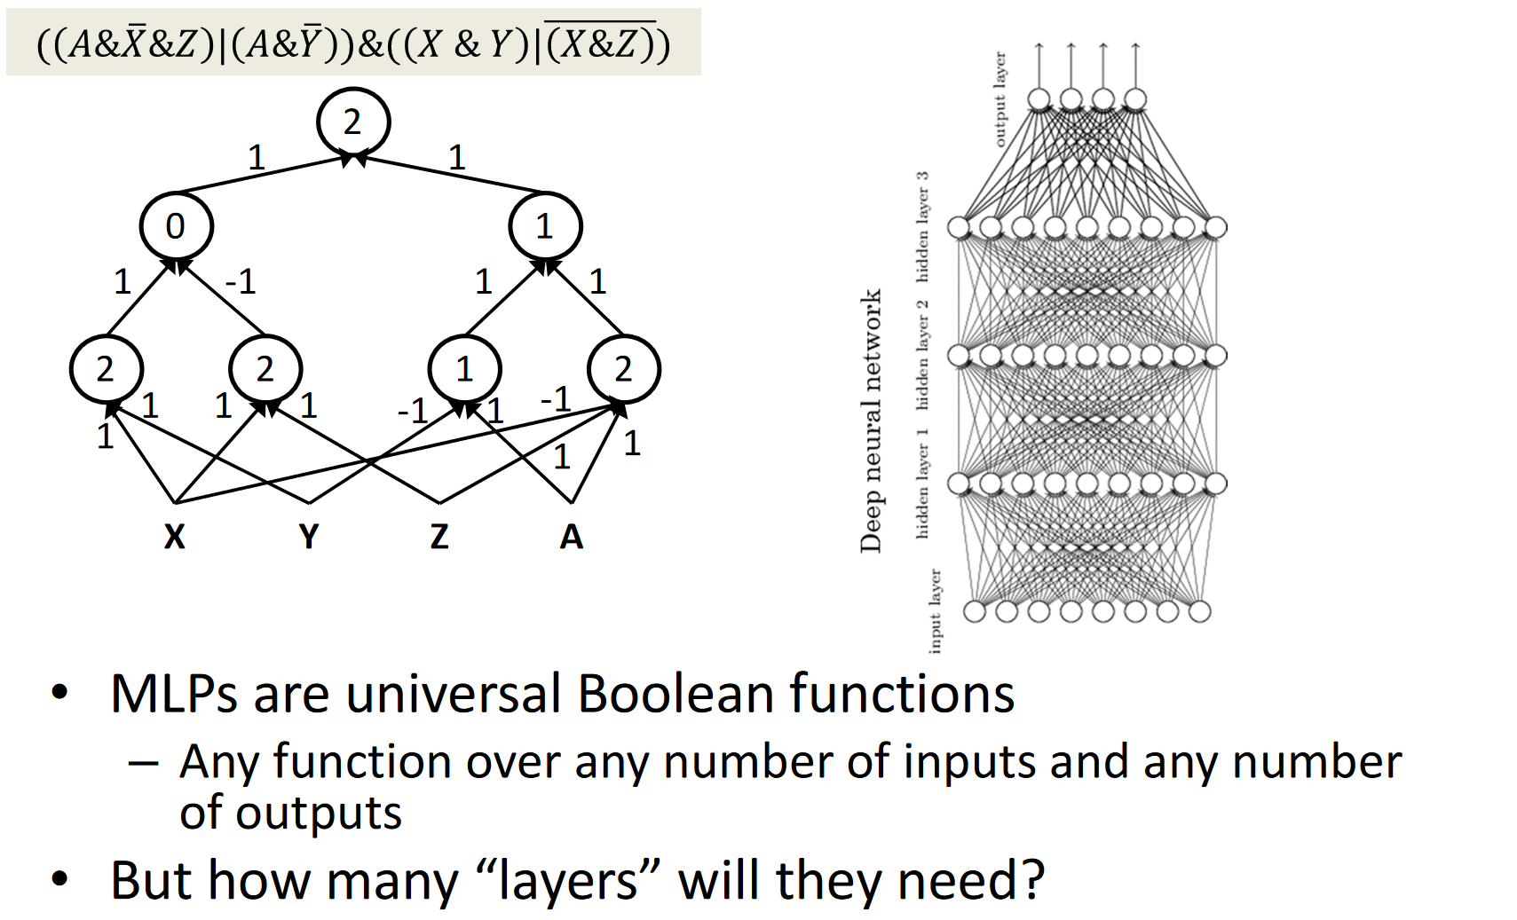

Slide 17
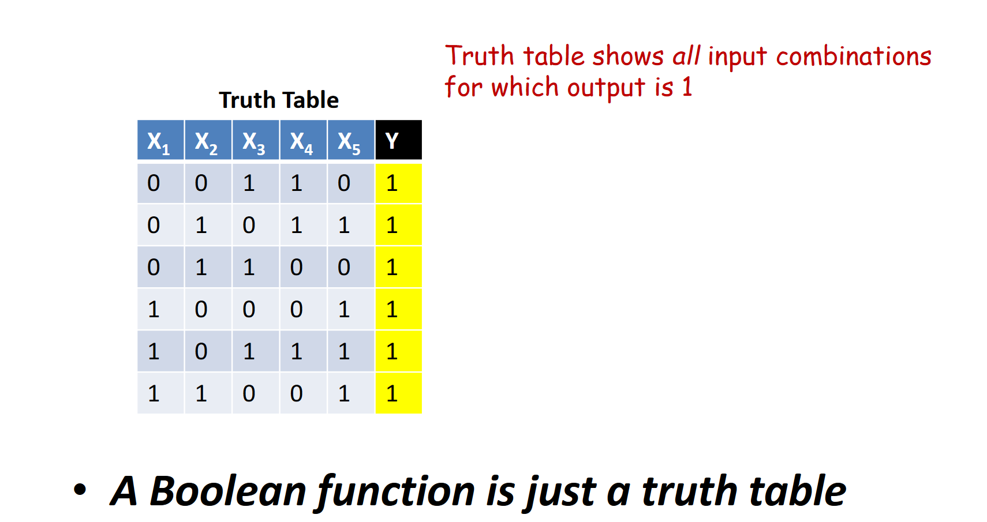

Slide 18
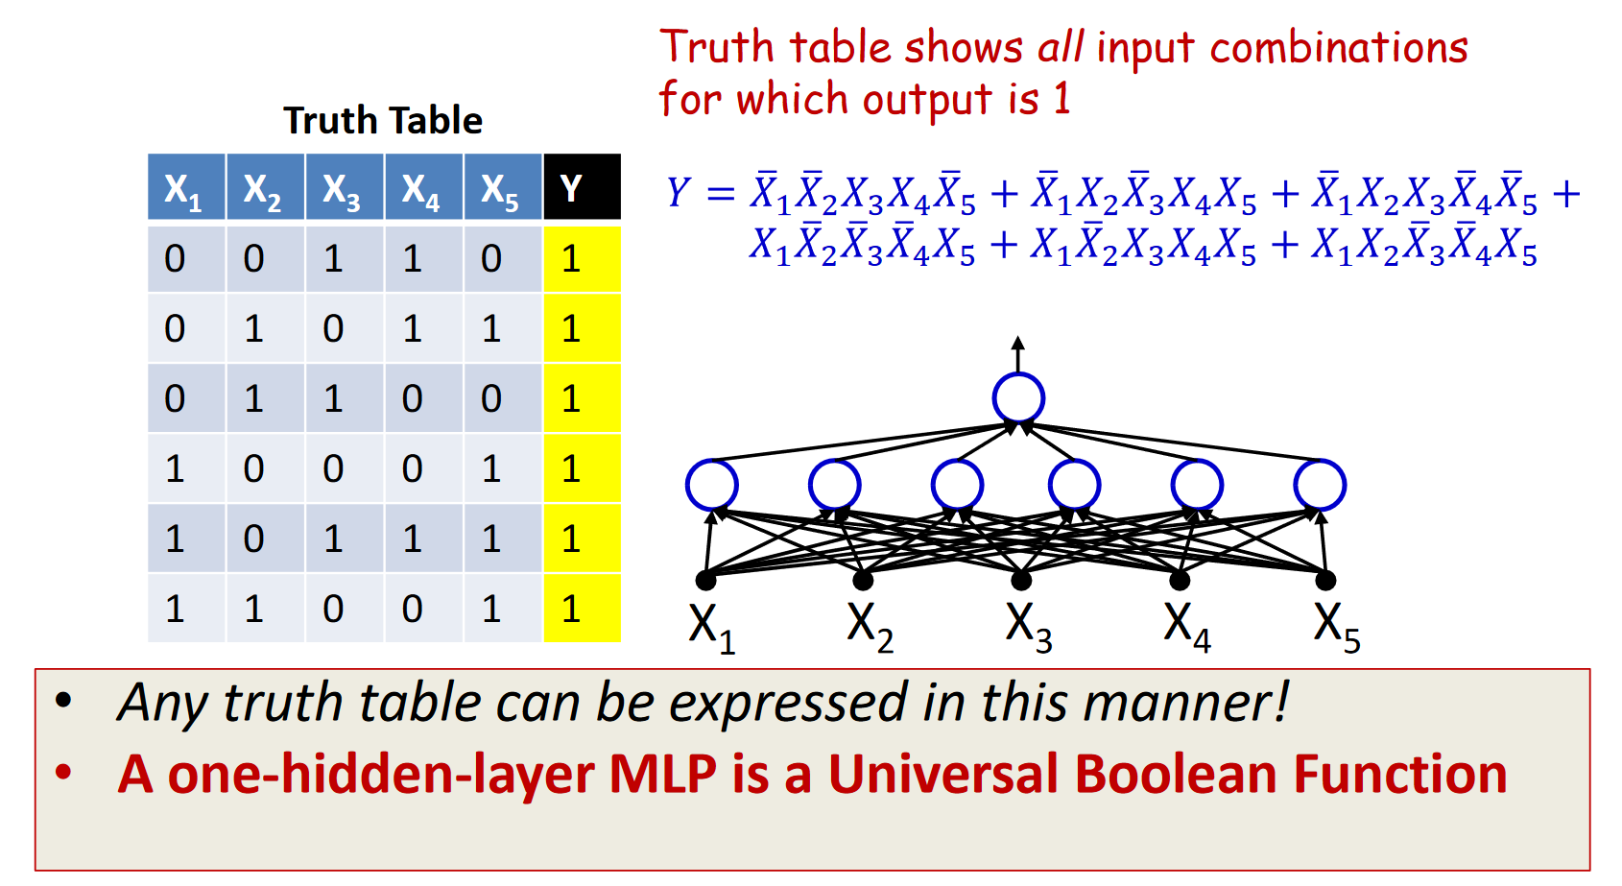

Slide 19
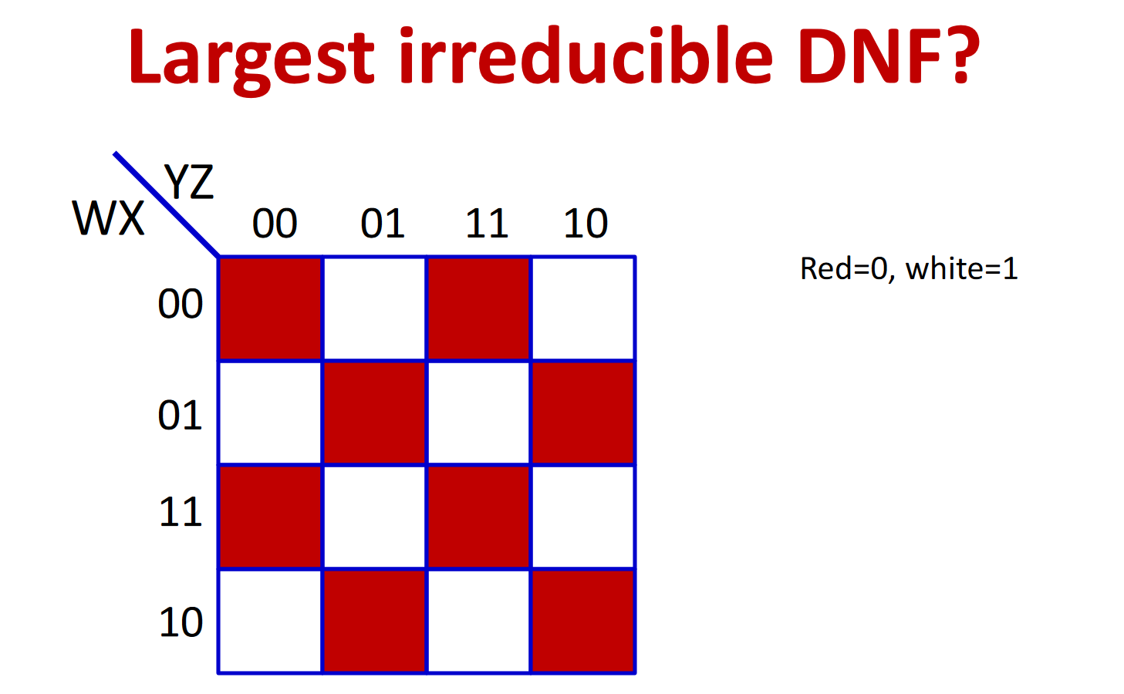

Slide 20
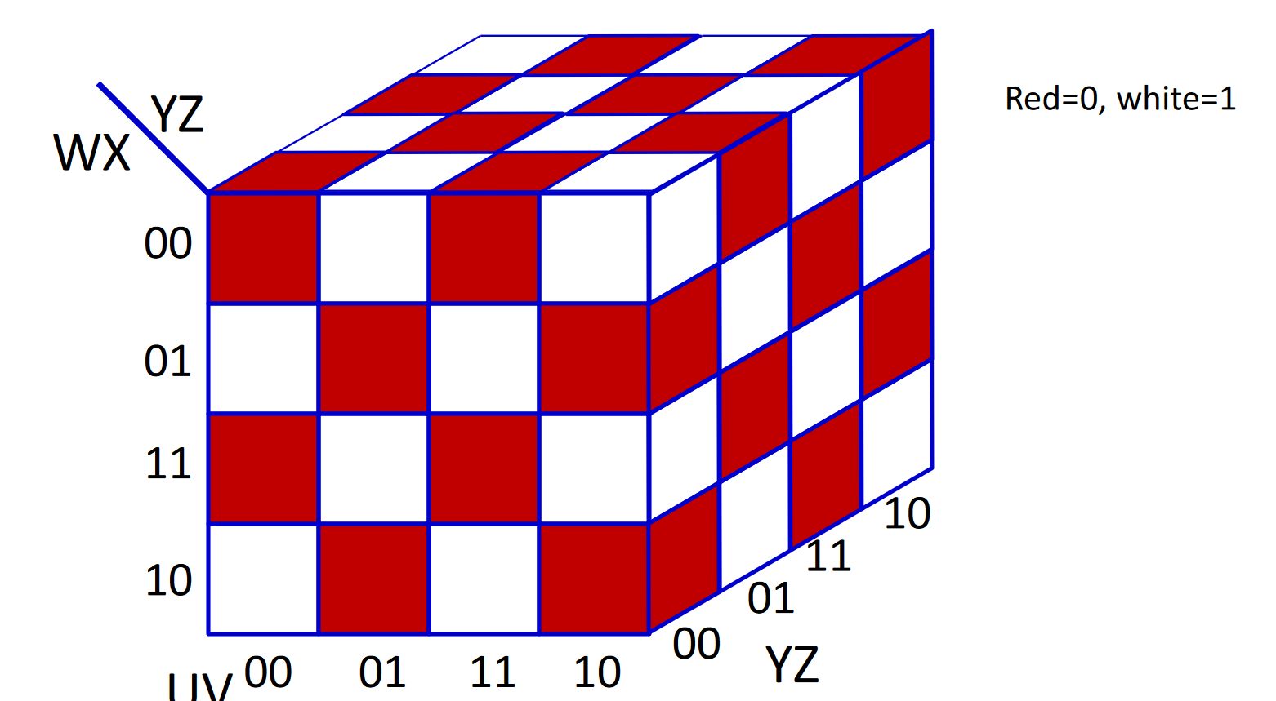

Slide 21
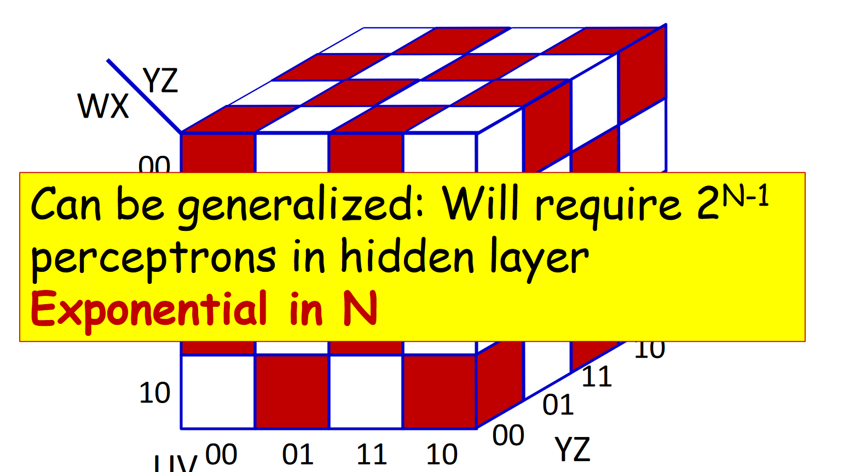

Slide 22
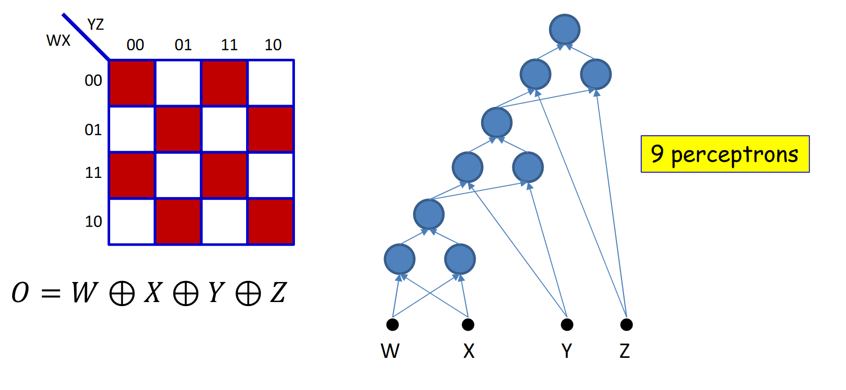

Slide 23
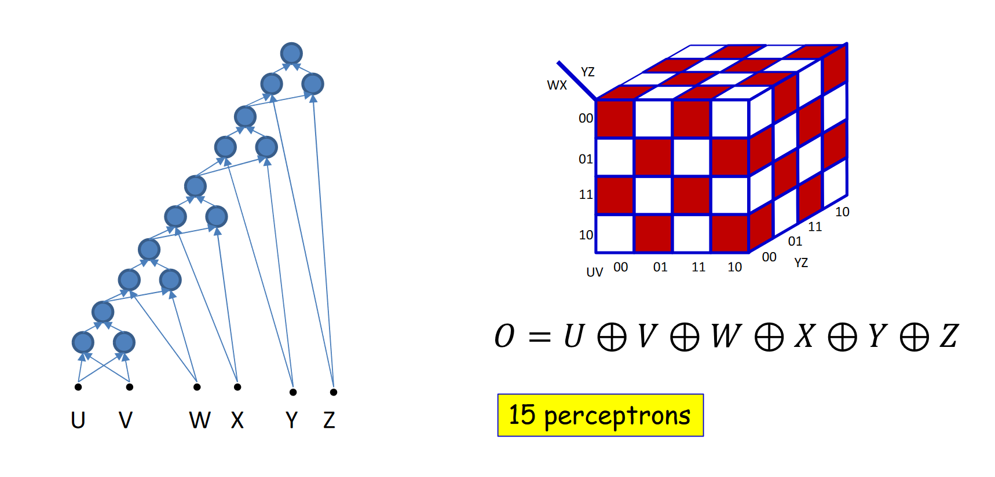

Slide 24
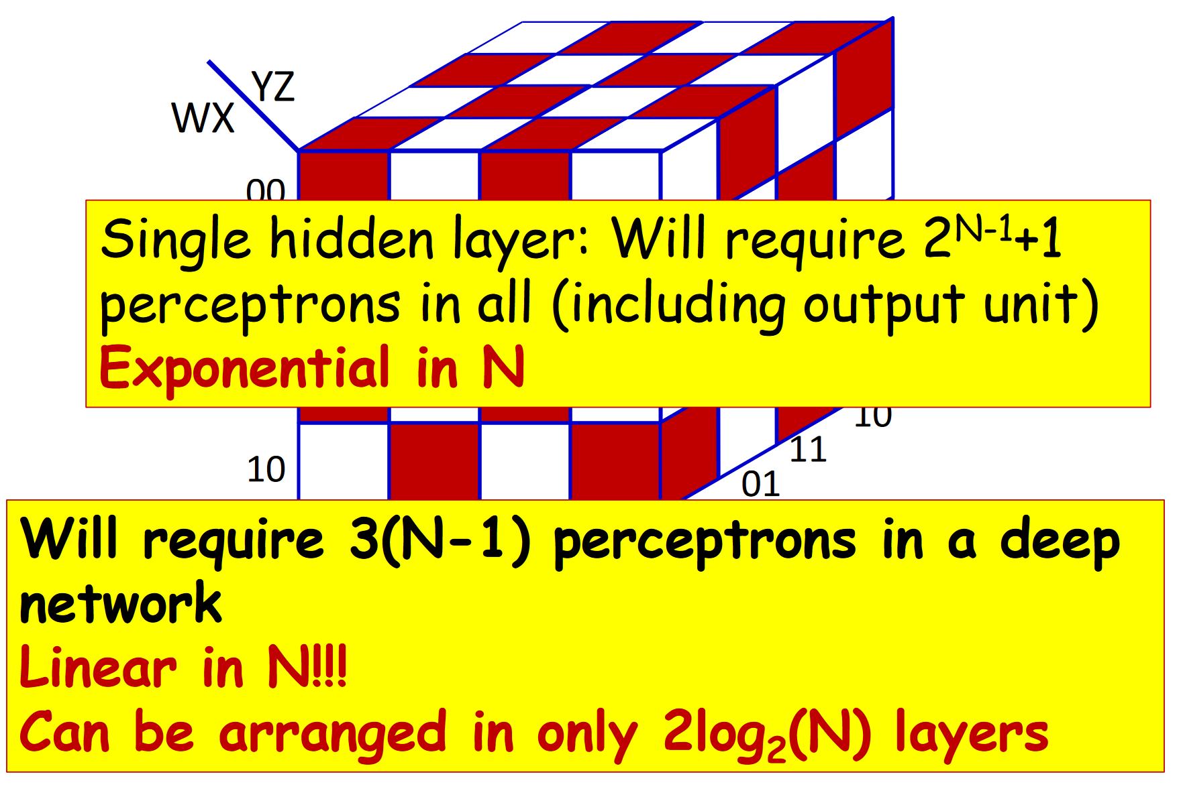

Slide 25
Reducing the number of layers below the minimum will result in an exponentially sized network to express the function fully
A network with fewer than the minimum required number of neurons cannot model the function

Slide 26
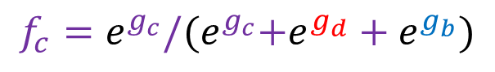
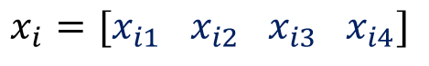
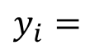
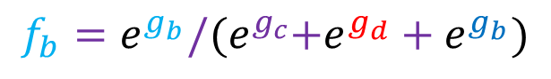
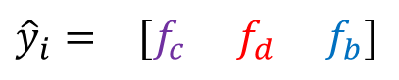
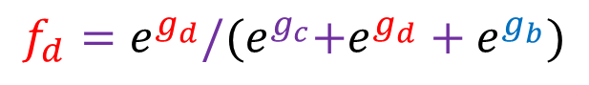
Linear Softmax
$$x_{i}=[x_{i1} { x}_{i2} x_{i3} { x}_{i4}]$$
$$y_{i}=$$
[1 0 0]
$${\hat{y}}_{i}= [f_{c} f_{d} f_{b}]$$
$$g_{c}=w_{c1}x_{i1}+w_{c2}x_{i2}+w_{c3}x_{i3}+w_{c4}x_{i4}+b_{c}$$
$$g_{d}=w_{d1}x_{i1}+w_{d2}x_{i2}+w_{d3}x_{i3}+w_{d4}x_{i4}+b_{d}$$
$$g_{b}=w_{b1}x_{i1}+w_{b2}x_{i2}+w_{b3}x_{i3}+w_{b4}x_{i4}+b_{b}$$
$$f_{c}=e^{g_{c}}/{(e}^{g_{c}}+e^{g_{d}}+e^{g_{b}})$$
$$f_{d}=e^{g_{d}}/{(e}^{g_{c}}+e^{g_{d}}+e^{g_{b}})$$
$$f_{b}=e^{g_{b}}/{(e}^{g_{c}}+e^{g_{d}}+e^{g_{b}})$$

Slide 27
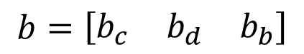
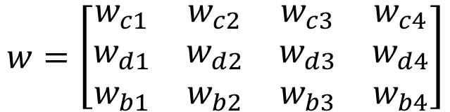
Linear Softmax
$$x_{i}=[x_{i1} { x}_{i2} x_{i3} { x}_{i4}]$$
$$y_{i}=$$
[1 0 0]
$${\hat{y}}_{i}= [f_{c} f_{d} f_{b}]$$
$$g_{c}=w_{c1}x_{i1}+w_{c2}x_{i2}+w_{c3}x_{i3}+w_{c4}x_{i4}+b_{c}$$
$$w=\left[\begin{matrix}w_{c1} & w_{c2} & w_{c3} & w_{c4} \\ w_{d1} & w_{d2} & w_{d3} & w_{d4} \\ w_{b1} & w_{b2} & w_{b3} & w_{b4}\end{matrix}\right]$$
$$g_{d}=w_{d1}x_{i1}+w_{d2}x_{i2}+w_{d3}x_{i3}+w_{d4}x_{i4}+b_{d}$$
$$g_{b}=w_{b1}x_{i1}+w_{b2}x_{i2}+w_{b3}x_{i3}+w_{b4}x_{i4}+b_{b}$$
$$b=\left[\begin{matrix}b_{c} & b_{d} & b_{b}\end{matrix}\right]$$
$$f_{c}=e^{g_{c}}/{(e}^{g_{c}}+e^{g_{d}}+e^{g_{b}})$$
$$f_{d}=e^{g_{d}}/{(e}^{g_{c}}+e^{g_{d}}+e^{g_{b}})$$
$$f_{b}=e^{g_{b}}/{(e}^{g_{c}}+e^{g_{d}}+e^{g_{b}})$$

Slide 28

Linear Softmax
$$x_{i}=[x_{i1} { x}_{i2} x_{i3} { x}_{i4}]$$
$$y_{i}=$$
[1 0 0]
$${\hat{y}}_{i}= [f_{c} f_{d} f_{b}]$$
$$w=\left[\begin{matrix}w_{c1} & w_{c2} & w_{c3} & w_{c4} \\ w_{d1} & w_{d2} & w_{d3} & w_{d4} \\ w_{b1} & w_{b2} & w_{b3} & w_{b4}\end{matrix}\right]$$
$$g=wx^{T}+b^{T}$$
$$b=\left[\begin{matrix}b_{c} & b_{d} & b_{b}\end{matrix}\right]$$
$$f_{c}=e^{g_{c}}/{(e}^{g_{c}}+e^{g_{d}}+e^{g_{b}})$$
$$f_{d}=e^{g_{d}}/{(e}^{g_{c}}+e^{g_{d}}+e^{g_{b}})$$
$$f_{b}=e^{g_{b}}/{(e}^{g_{c}}+e^{g_{d}}+e^{g_{b}})$$

Slide 29
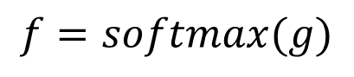
Linear Softmax
$$x_{i}=[x_{i1} { x}_{i2} x_{i3} { x}_{i4}]$$
$$y_{i}=$$
[1 0 0]
$${\hat{y}}_{i}= [f_{c} f_{d} f_{b}]$$
$$w=\left[\begin{matrix}w_{c1} & w_{c2} & w_{c3} & w_{c4} \\ w_{d1} & w_{d2} & w_{d3} & w_{d4} \\ w_{b1} & w_{b2} & w_{b3} & w_{b4}\end{matrix}\right]$$
$$g=wx^{T}+b^{T}$$
$$b=\left[\begin{matrix}b_{c} & b_{d} & b_{b}\end{matrix}\right]$$
$$f=softmax(g)$$

Slide 30

Linear Softmax
$$x_{i}=[x_{i1} { x}_{i2} x_{i3} { x}_{i4}]$$
$$y_{i}=$$
[1 0 0]
$${\hat{y}}_{i}= [f_{c} f_{d} f_{b}]$$
$$f=softmax(wx^{T}+b^{T})$$

Slide 31


Two-layer MLP + Softmax
$$x_{i}=[x_{i1} { x}_{i2} x_{i3} { x}_{i4}]$$
$$y_{i}=$$
[1 0 0]
$${\hat{y}}_{i}= [f_{c} f_{d} f_{b}]$$
$$a_{1}=sigmoid(w_{[1]}x^{T}+b_{[1]}^{T})$$
$$f=softmax(w_{[2]}{a[1]}^{T}+b_{[2]}^{T})$$

Slide 32





N-layer MLP + Softmax
$$x_{i}=[x_{i1} { x}_{i2} x_{i3} { x}_{i4}]$$
$$y_{i}=$$
[1 0 0]
$${\hat{y}}_{i}= [f_{c} f_{d} f_{b}]$$
$$a_{1}=sigmoid(w_{[1]}x^{T}+b_{[1]}^{T})$$
$$a_{2}=sigmoid(w_{[2]}a_{1}^{T}+b_{[2]}^{T})$$
$$…$$
$$a_{k}=sigmoid(w_{[k]}a_{k−1}^{T}+b_{[k]}^{T})$$
$$…$$
$$f=softmax(w_{[n]}a_{n−1}^{T}+b_{[n]}^{T})$$

Slide 33
Some insights to the learned function
Activation function
Rectified Linear Unit
(particular kind of activation function)

Slide 34
Example shallow network
Activation function
Rectified Linear Unit
(particular kind of activation function)

Slide 35
Example shallow network
This model has 10 parameters:
Represents a family of functions
Parameters determine particular function
Given parameters can perform inference (run equation)
Given training dataset
Define loss function (least squares)
Change parameters to minimize loss function

Slide 36
Example shallow network

Slide 37
Example shallow network
Piecewise linear functions with three joints

Slide 38
Hidden units
Break down into two parts:
where:
Hidden units

Slide 39
1. compute three linear functions

Slide 40
2. Pass through ReLU functions (creates hidden units)

Slide 41
2. Weight the hidden units

Slide 42
4. Sum the weighted hidden units to create output

Slide 43
Example shallow network
Example shallow network = piecewise linear functions
1 “joint” per ReLU function

Slide 44
Activation pattern = which hidden units are activated
Shaded region:
Unit 1 active
Unit 2 inactive
Unit 3 active

Slide 45
Depicting neural networks
Each parameter multiplies its source and adds to its target

Slide 46
With 3 hidden units:
With D hidden units:

Slide 47
With enough hidden units…
… we can describe any 1D function to arbitrary accuracy

Slide 48
Universal approximation theorem
“a formal proof that, with enough hidden units, a shallow neural network can describe any continuous function on a compact subset of to arbitrary precision”

Slide 49


Why is non-linearity important

Slide 50






How to train the parameters?
$$x_{i}=[x_{i1} { x}_{i2} x_{i3} { x}_{i4}]$$
$$y_{i}=$$
[1 0 0]
$${\hat{y}}_{i}= [f_{c} f_{d} f_{b}]$$
$$a_{1}=sigmoid(w_{[1]}x^{T}+b_{[1]}^{T})$$
$$a_{2}=sigmoid(w_{[2]}a_{1}^{T}+b_{[2]}^{T})$$
$$…$$
$$a_{k}=sigmoid(w_{[k]}a_{k−1}^{T}+b_{[k]}^{T})$$
$$…$$
$$f=softmax(w_{[n]}a_{n−1}^{T}+b_{[n]}^{T})$$

Slide 51




How to train the parameters?
$$x_{i}=[x_{i1} { x}_{i2} x_{i3} { x}_{i4}]$$
$$y_{i}=$$
[1 0 0]
$${\hat{y}}_{i}= [f_{c} f_{d} f_{b}]$$
$$a_{1}=sigmoid(w_{[1]}x^{T}+b_{[1]}^{T})$$
$$l=loss(f, y)$$
$$a_{2}=sigmoid(w_{[2]}a_{1}^{T}+b_{[2]}^{T})$$
$$…$$
We can still use SGD
$$a_{k}=sigmoid(w_{[k]}a_{k−1}^{T}+b_{[i]}^{T})$$
$$…$$
We need!
$$\frac{∂l}{∂w_{[k]ij}}$$
$$\frac{∂l}{∂b_{\left[k\right]i}}$$
$$f=softmax(w_{[n]}a_{n−1}^{T}+b_{[n]}^{T})$$

Slide 52


Slide 54
The log function is monotonic
Maximum of the logarithm of a function is in the same place as maximum of function

Slide 55
Maximum log likelihood
Now it’s a sum of terms, so doesn’t matter so much if the terms are small

Slide 56
Minimizing negative log likelihood
By convention, we minimize things (i.e., a loss)

Slide 57


Slide 58





Slide 59


Slide 60


Slide 61


Slide 62

Backpropagation – repeated application of chain rule

Slide 63


Slide 64


Slide 65


Slide 66


Slide 67





Slide 68

Image classification
Multiclass classification problem (discrete classes, >2 possible classes)
Convolutional network

Slide 69

Object detection

Slide 70

Image segmentation
Multivariate binary classification problem (many outputs, two discrete classes)
Convolutional encoder-decoder network

Slide 71
Invariance
A function f[x] is invariant to a transformation t[] if:
i.e., the function output is the same even after the transformation is applied.

Slide 72

Invariance example
e.g., Image classification
Image has been translated, but we want our classifier to give the same result

Slide 73
Equivariance
A function f[x] is equivariant to a transformation t[] if:
i.e., the output is transformed in the same way as the input

Slide 74


Equivariance example
e.g., Image segmentation
Image has been translated and we want segmentation to translate with it

Slide 75
Basic building blocks of the CNN architecture
Input layer
Convolutional layer
Fully connected layer
Loss layer
Convolutional layer
Convolutional kernel
Pooling layer
Non-linearity

Slide 76


Convolution operation

Slide 77




Same pattern appears in different places: They can be compressed! What about training a lot of such “small” detectors and each detector must “move around”.
“upper-left beak” detector
They can be compressed
to the same parameters.
“middle beak” detector

Slide 78

Convolution v.s. Fully Connected
1 | 0 | 0 | 0 | 0 | 1
0 | 1 | 0 | 0 | 1 | 0
0 | 0 | 1 | 1 | 0 | 0
1 | 0 | 0 | 0 | 1 | 0
0 | 1 | 0 | 0 | 1 | 0
0 | 0 | 1 | 0 | 1 | 0
1 | -1 | -1
-1 | 1 | -1
-1 | -1 | 1
-1 | 1 | -1
-1 | 1 | -1
-1 | 1 | -1
convolution
image
1 | 0 | 0 | 0 | 0 | 1
0 | 1 | 0 | 0 | 1 | 0
0 | 0 | 1 | 1 | 0 | 0
1 | 0 | 0 | 0 | 1 | 0
0 | 1 | 0 | 0 | 1 | 0
0 | 0 | 1 | 0 | 1 | 0
Fully-connected
……
……

Slide 79
Convolution* in 1D
Input vector x:
Output is weighted sum of neighbors:
Convolutional kernel or filter:
Kernel size = 3
* Not really technically convolution

Slide 80
Convolution with kernel size 3

Slide 81
Convolution with kernel size 3

Slide 82
Convolution with kernel size 3
Equivariant to translation of input

Slide 83
Zero padding
Treat positions that are beyond end of the input as zero.

Slide 84
“Valid” convolutions
Only process positions where kernel falls in image (smaller output).

Slide 85
Stride, kernel size, and dilation
Stride = shift by k positions for each output
Decreases size of output relative to input
Kernel size = weight a different number of inputs for each output
Combine information from a larger area
But kernel size 5 uses 5 parameters
Dilated or atrous convolutions = intersperse kernel values with zeros
Combine information from a larger area
Fewer parameters

Slide 86
1

Slide 87
1
1

Slide 88
1
1
1

Slide 89
1
1
1
2

Slide 90
Receptive fields

Slide 91
Receptive fields

Slide 92
Receptive fields

Slide 93
Receptive fields

Slide 94

MNIST digits classification

Slide 95
Performance

Slide 96
Why?
Better inductive bias
Forced the network to process each location similarly
Shares information across locations
Search through a smaller family of input/ouput mappings, all of which are plausible

Slide 97
2D Convolution
Convolution in 2D
Weighted sum over a K x K region
K x K weights
Build into a convolutional layer by adding bias and passing through activation function

Slide 98
2D Convolution

Slide 99
2D Convolution

Slide 100

Channels in 2D convolution
Kernel size, stride, dilation all work as you would expect

Slide 101
How many parameters?
If there are${ C}_{i}$ input channels and kernel size K x K
If there are${ C}_{i}$ input channels and ${ C}_{o}$ output channels

Slide 102

Convolutional Layer (with 4 filters)
weights: 4x1x9x9
Input: 1x224x224
Output: 4x224x224
if zero padding,
and stride = 1

Slide 103
Convolutional Layer (with 4 filters)
weights: 4x1x9x9
Input: 1x224x224
Output: 4x112x112
if zero padding,
but stride = 2

Slide 104

Color image: RGB 3 channels – conv. over depth
1 | -1 | -1
-1 | 1 | -1
-1 | -1 | 1
-1 | 1 | -1
-1 | 1 | -1
-1 | 1 | -1
1 | -1 | -1
-1 | 1 | -1
-1 | -1 | 1
-1 | 1 | -1
-1 | 1 | -1
-1 | 1 | -1
1 | -1 | -1
-1 | 1 | -1
-1 | -1 | 1
-1 | 1 | -1
-1 | 1 | -1
-1 | 1 | -1
Filter 1
Filter 2 …3
Color image
1 | 0 | 0 | 0 | 0 | 1
0 | 1 | 0 | 0 | 1 | 0
0 | 0 | 1 | 1 | 0 | 0
1 | 0 | 0 | 0 | 1 | 0
0 | 1 | 0 | 0 | 1 | 0
0 | 0 | 1 | 0 | 1 | 0
1 | 0 | 0 | 0 | 0 | 1
0 | 1 | 0 | 0 | 1 | 0
0 | 0 | 1 | 1 | 0 | 0
1 | 0 | 0 | 0 | 1 | 0
0 | 1 | 0 | 0 | 1 | 0
0 | 0 | 1 | 0 | 1 | 0
1 | 0 | 0 | 0 | 0 | 1
0 | 1 | 0 | 0 | 1 | 0
0 | 0 | 1 | 1 | 0 | 0
1 | 0 | 0 | 0 | 1 | 0
0 | 1 | 0 | 0 | 1 | 0
0 | 0 | 1 | 0 | 1 | 0

Slide 105


Different types of convolution
Parameters:
Kernel stride
Size
Padding
Normal vs dialated
Dialation width = 2

Slide 106

Dialated convolution

Slide 107


Spatially Separable convolution

Slide 108

Depthwise separable convolution
Convolving by 256 5x5 kernels over the input volume

Slide 109


Depthwise separable convolution – step1
Along depth

Slide 110


Depthwise separable convolution – step2
1x1 conv
Pointwise

Slide 111


Slide 112






Slide 113
Downsampling
Sample every other position (equivalent to stride two)

Slide 114
Downsampling
Sample every other position (equivalent to stride two)
Max pooling
(partial invariance to translation)

Slide 115
Downsampling
Sample every other position (equivalent to stride two)
Max pooling
(partial invariance to translation)
Mean pooling

Slide 116


Why Pooling
Subsampling pixels will not change the object
bird
bird
Subsampling
We can subsample the pixels to make image smaller
fewer parameters to characterize the image

Slide 117

Pooling or strided convolution?

Slide 118
Upsampling
Duplicate

Slide 119
Upsampling
Duplicate
Max-upsampling

Slide 120
Upsampling
Duplicate
Max-upsampling
Bilinear interpolation

Slide 121
Transposed convolutions
Kernel size 3, Stride 2 convolution

Slide 122
Transposed convolutions
Kernel size 3, Stride 2 convolution
Transposed convolution

Slide 123

Convolution as matrix vector multiplication

Slide 124


Slide 125



Slide 126




Convolution as a matrix multiplication

Slide 127


Many to one mapping – 9 values to 1 value

Slide 128



One to many mapping

Slide 129


The whole CNN
cat dog ……
Convolution
Max Pooling
Can repeat many times
Fully Connected Feedforward network
Convolution
Max Pooling
Flattened

Slide 130
The whole CNN
cat dog ……
Convolution
Max Pooling
Fully Connected Feedforward network
A new image
Convolution
Max Pooling
Flattened
A new image

Slide 131


Slide 132
Flattening
3
0
1
3
0
-1
1
3
3
1
-1
0
3
Flattened
1
Fully Connected Feedforward network
0
3

Slide 133
Conv Net Topology
5 convolutional layers
3 fully connected layers + soft-max
650K neurons , 60 Mln weights

Slide 134


Slide 135
Why do we need a deep CNN?

Slide 136
Why do we need a deep CNN?

Slide 137
Why do we need a deep CNN?

Slide 138
Why do we need a deep CNN?

Slide 139
Why do we need a deep CNN?

Slide 140

Suggested reading

